Slide 1



Karnatak Law Society’s
Gogte Institute Of Technology, Belagavi
(A Permanently Affiliated and Autonomous Institute under Visvesvaraya Technological University, Belagavi | Accredited by NAAC A+ & NBA)
Department of Information Science and Engineering
Project Phase 1
“Mood-Based Music Recommendation Web App with Playback”
Rajat Kulkarni Rajvardhan More Siddappa Hirekurabar Vinayak Chinchakhandi
2GI23IS076 2GI23IS077 2GI23IS099 2GI23IS118
Under the Guidance of:
Dr.K.S.Mathad
Assistant Professor Dept. of ISE, KLSGIT, Belagavi

Slide 2
Problem Statement and Objectives
Problem Statement:
With millions of songs online, users often face difficulty in selecting tracks that reflect their current mood. Existing systems emphasize past listening habits, genres, or popularity trends, and fail to consider real-time emotional context, leaving users spending excessive time searching for appropriate music. Additionally, full playback is restricted in many platforms for free users, limiting accessibility.
Objectives :
Design and develop a full-stack web application that recommends music based on user-selected mood or text-based sentiment analysis.
Integrate Audio and YouTube APIs to retrieve song data and provide full-song playback through embedded players.
Check if the Machine Learning model is working correctly by verifying that facial expressions are accurately detected and the corresponding mood is generated as output.
Department of Information Science and Engineering,
KLS GIT, Belagavi

Slide 3
Literature Survey
Existing Systems (Spotify, YouTube Music, etc.):
Primarily rely on historical user behavior, collaborative/content-based filtering, and popularity trends. They are effective for generic personalization but lack real-time emotion-based recommendations.
Recent Research & Studies:
Sentiment Analysis (IEEE, 2020): Used NLP to classify text input and map it to music recommendations based on emotional categories.
Deep Learning Models (Elsevier, 2021): Applied deep neural networks to map mood embeddings with song metadata for high-accuracy emotion-based recommendations.
Context-Aware Systems (ACM, 2022): Highlighted the need for integrating environmental and temporal factors (like time, location) alongside mood for better accuracy.
Audio Features (Springer, 2020): Focused on extracting musical features (e.g., tempo, pitch, rhythm) to directly predict song emotion tags.
Hybrid Systems (ResearchGate, 2021): Combined collaborative filtering with mood recognition to create more personalized and effective hybrid systems.
Department of Information Science and Engineering,
KLS GIT, Belagavi

Slide 4
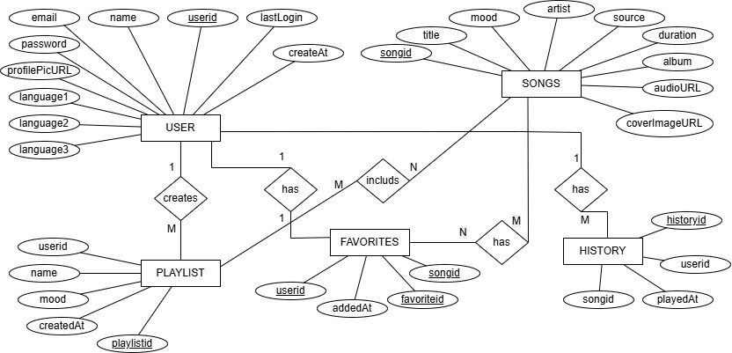
Design Details
ER Diagram :
Department of Information Science and Engineering,
KLS GIT, Belagavi

Slide 5
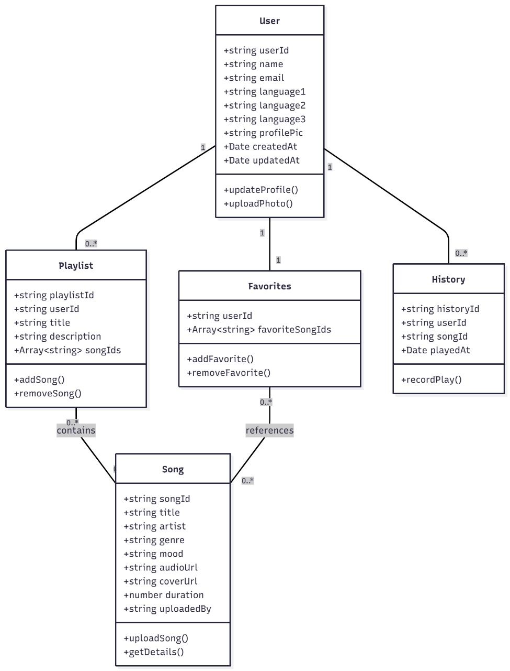
Class Diagram

Slide 6
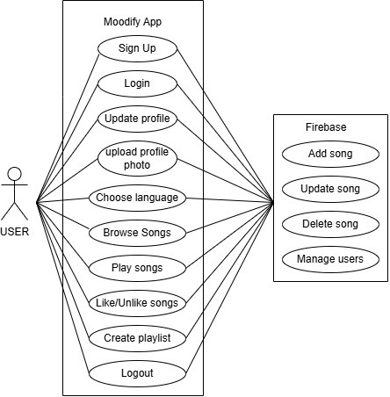
Use Case Diagram :
Department of Information Science and Engineering,
KLS GIT, Belagavi

Slide 7
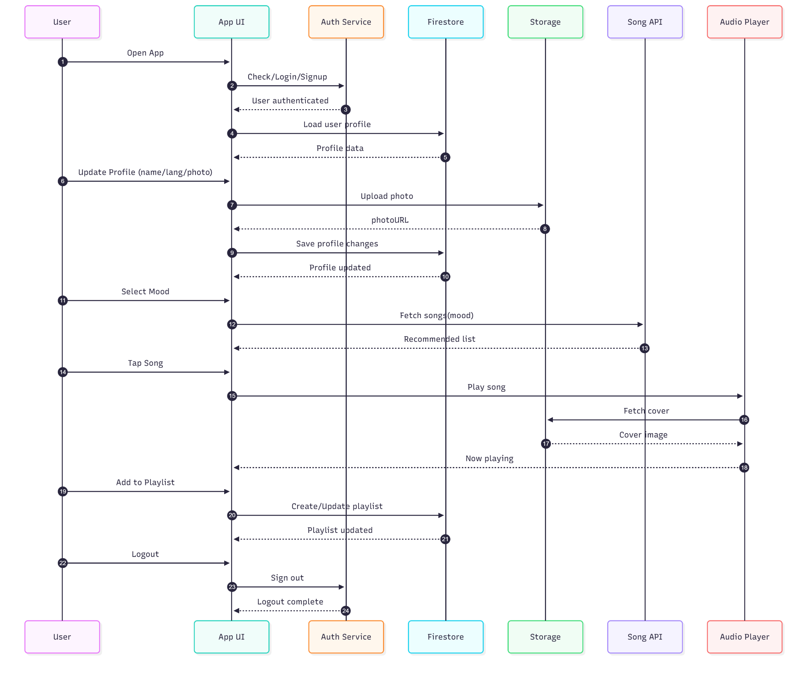
Sequence Diagram :
Department of Information Science and Engineering,
KLS GIT, Belagavi

Slide 8
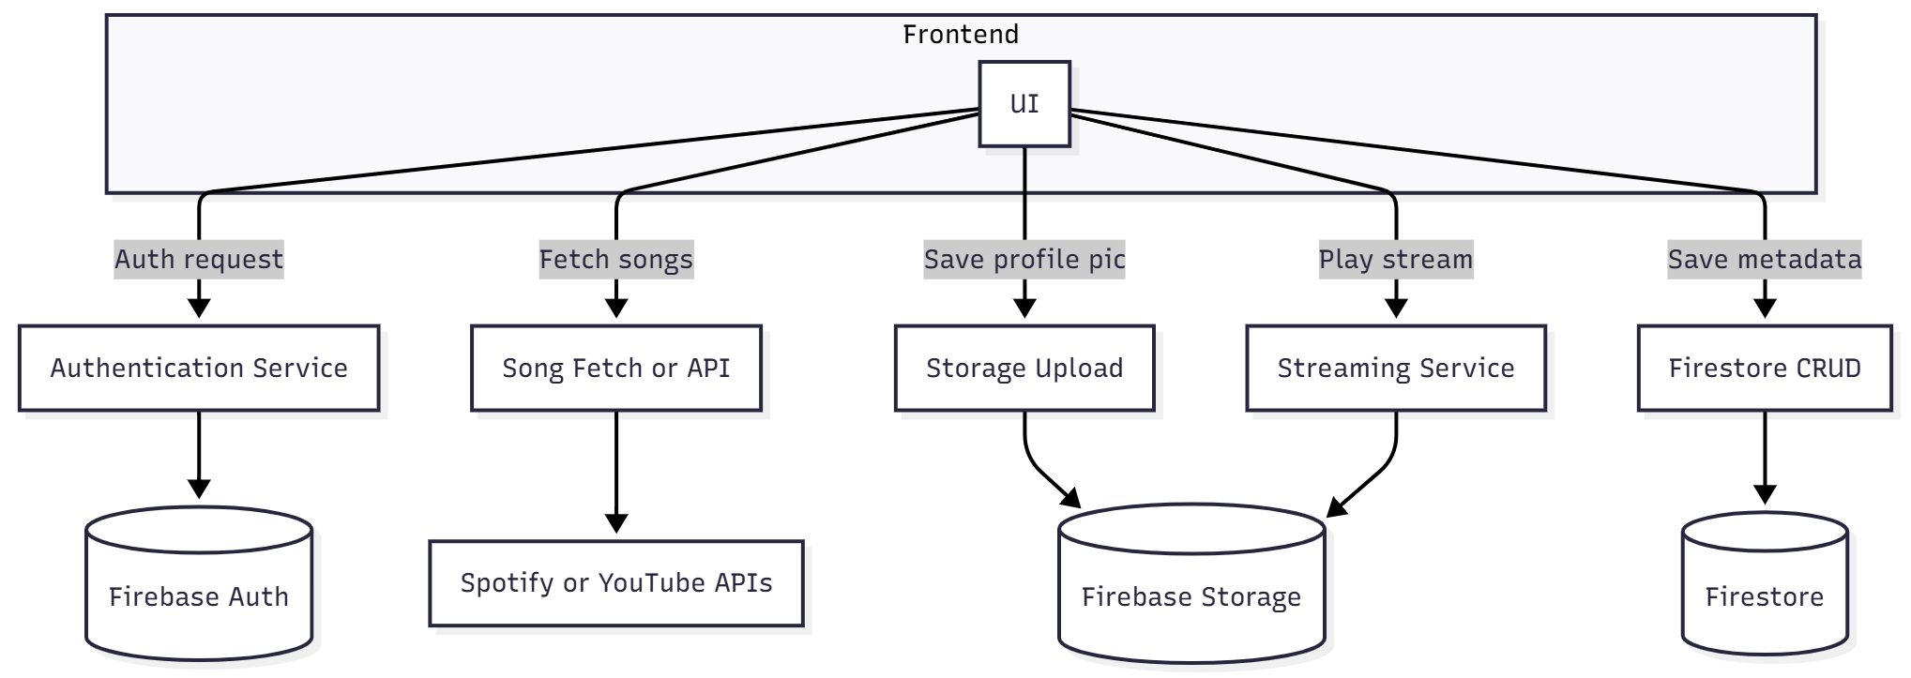
Data Flow Diagram :
Department of Information Science and Engineering,
KLS GIT, Belagavi

Slide 9
Feasibility Study
Technical Feasibility :
React + Node.js easily supported
Firebase authentication & Firestore for backend and database
Spotify & YouTube APIs free and reliable
Hugging Face ML model ready-made
Firebase Hosting supports fast global deployment
Operational Feasibility :
Simple, user-friendly interface
Optional camera-based mood detection
Smooth playback via YouTube embed
Easy login & data sync using Firebase
Economic Feasibility :
No paid APIs required
Firebase Free Tier covers auth,database,hosting
Uses open-source tools & models
Overall low-cost and student-friendly
Department of Information Science and Engineering,
KLS GIT, Belagavi

Slide 10
Requirement Analysis
Functional Requirements :
Mood selection (Happy, Sad, Energetic, Relaxed)
Mood detection using facial expressions or text sentiment
Fetch song metadata using Spotify API
YouTube embedded player for playback
Save favorite songs using Firebase Firestore
Store mood-wise listening history
User login & authentication via Firebase
Responsive UI for mobile and desktop
Non-Functional Requirements :
Fast API responses and minimal loading time
Smooth and uninterrupted playback
Secure handling of user data and API keys
Scalable backend using Firebase services
Simple, intuitive, and user-friendly interface
High availability and reliable data sync
Cross-browser and cross-device compatibility
Error handling for API or network failures
Department of Information Science and Engineering,
KLS GIT, Belagavi

Slide 11
THANK YOU…

